Slide 1
Team Hydrogen
CS504 Team Project
Spring 2021

Slide 2





Team Hydrogen Members
Ryan Vavra
Lucien Wobembong
Glenn Turner
Kevin Uruena
Michael Walsh
Product Owner
Scrum Master
Developer
Developer
Developer
Notes:
1.15

Slide 3
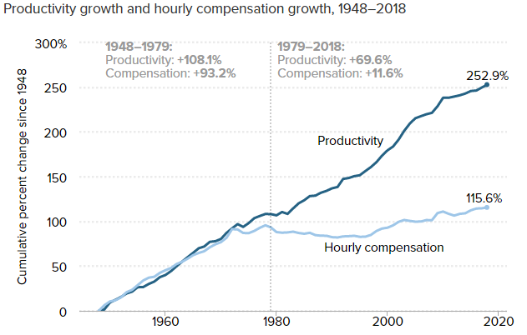
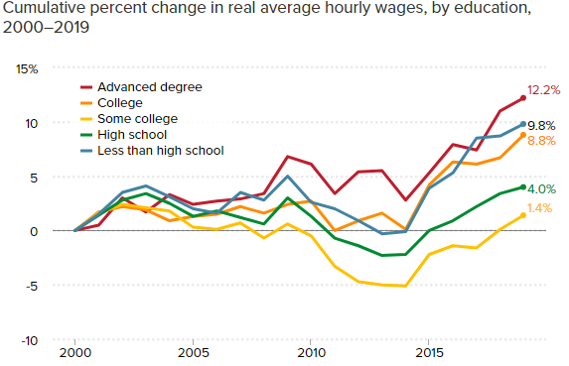
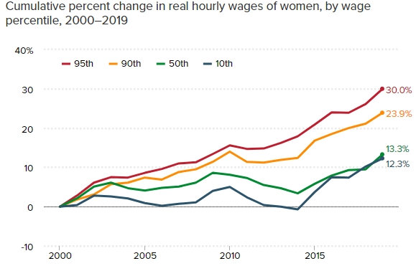
Problem Definition
Problem
Objective
The disparity between compensation and productivity has greatly increased over the past 40 years. Attributes such as education, location, gender, and hours worked, also affect compensation
Team Hydrogen wants to help employees see which factors are most important in earning a higher salary and employers determine fair salary to offer based on job requirements
Notes:
2 min
Lucien

Slide 4
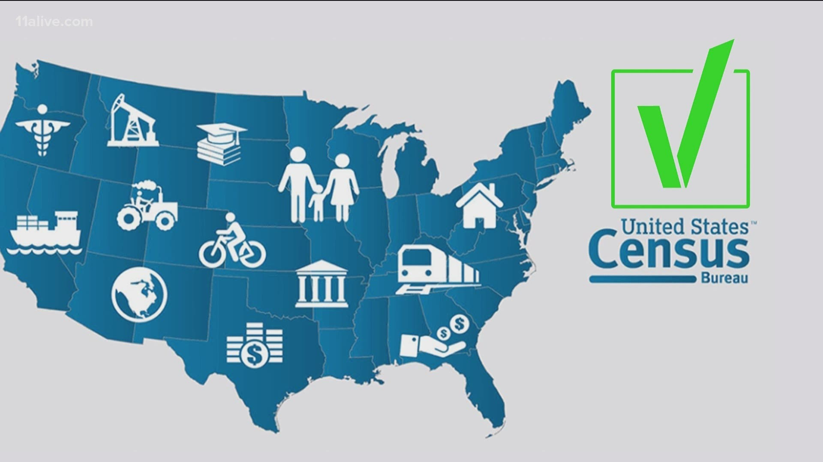


Dataset Overview
Original Inspiration: Adult Data Set from UCI Irvine based on 1994 Census
Cons: outdated, only categorical attribute for salary (less than or higher than 50K)
New Data Sets from Census.gov
ASEC 2019, 2020 Record Type Person
ASEC 2019, 2020 Record Type Household
Final Data Set
Combination of both Person and Household from 2019 and 2020 using common key household sequence number
Gives personal information as well as location related attributes
338,060 entries, 843 attributes (40 used for analysis )
Notes:
2min
Ryan

Slide 5
Data Quality Assessment
Data Conditioning
Completeness
Data was trimmed from 840 to 40 attributes. Resulting dataset was 338,060 entries
Unique
Census Bureau collects data on thousands of attributes. Our dataset contains unique attributes and values
Examine fields provided and select those that are germane to our analysis
Perform an initial cleansing of the data, removing blanks and NULL values
Create subset of data that meets our requirements analysis
Analyzed with and without outliers
Accuracy
Census Bureau has a “Census Quality Indicators Task Force” who check for quality and accuracy in their data collection
Conformity
Census Bureau has a “Census Quality Indicators Task Force” who check for quality and accuracy in their data collection
Notes:
Mike

Slide 6

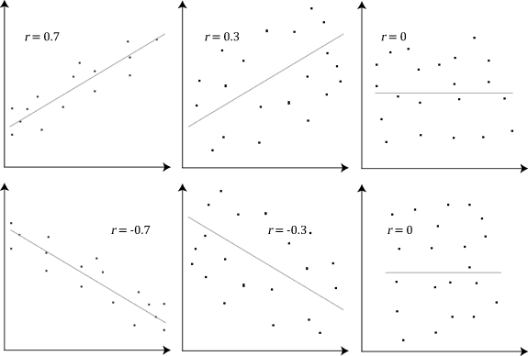
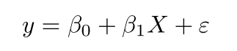
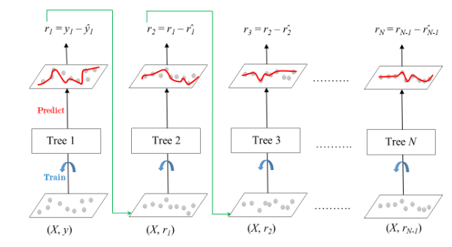
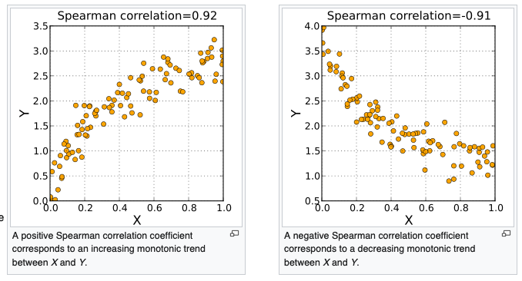
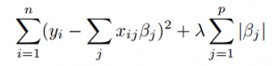
Algorithm & Analytics
Random Forest
Pearson Correlation
Linear Regression
Gradient Boosting
Spearman Correlation
Lasso Regression
Notes:
We will need a 2-minute sound track that talks and provides an overview of these 5 analytics.
Mike = Pearson and Spearman Correlation
Glenn –Random +Regressions
Kevin -XGB

Slide 7
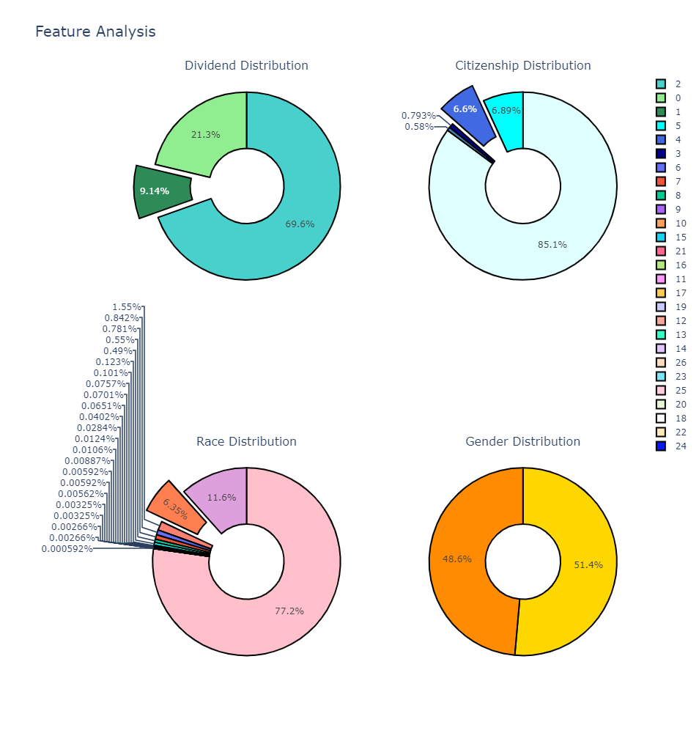
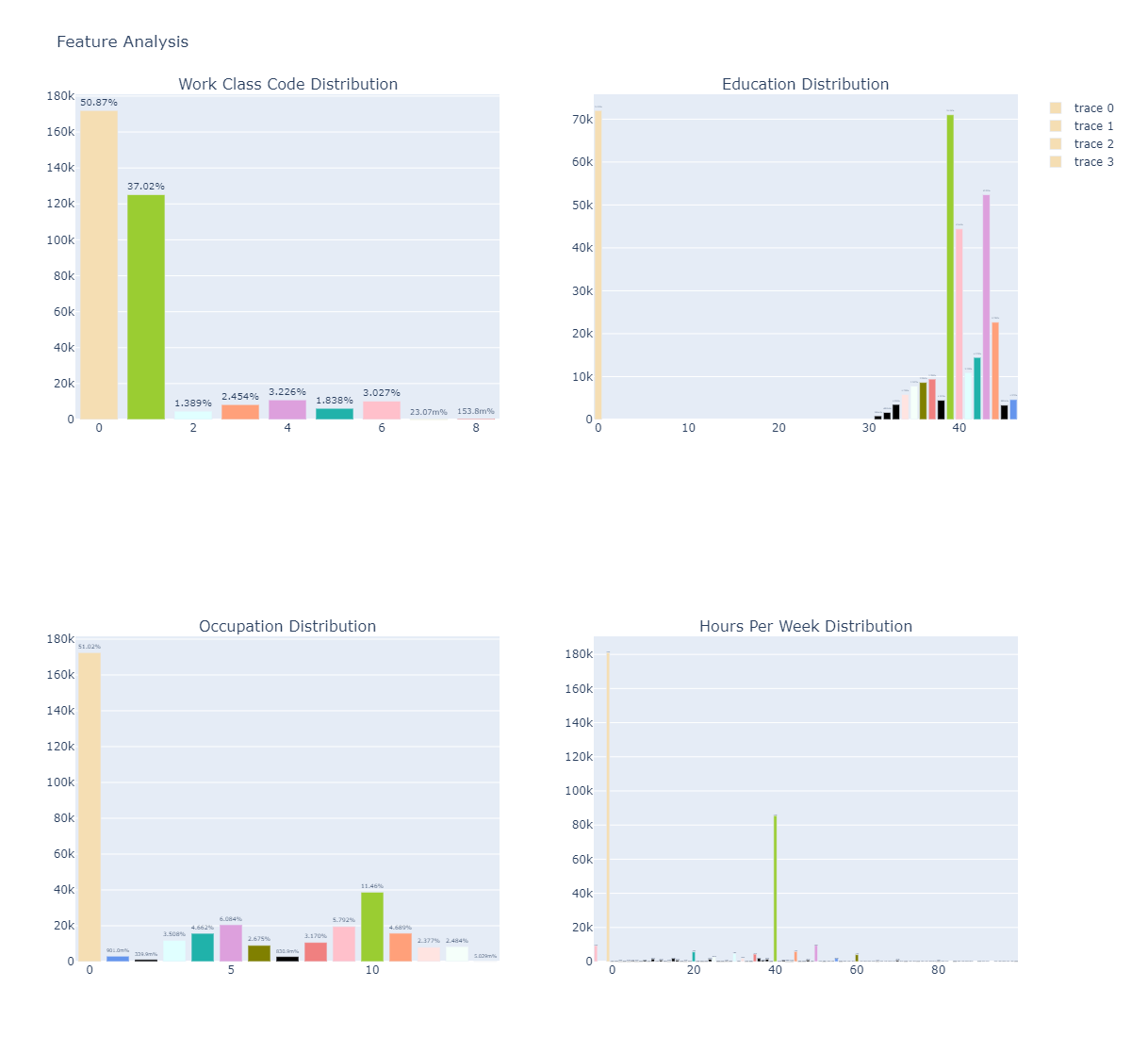
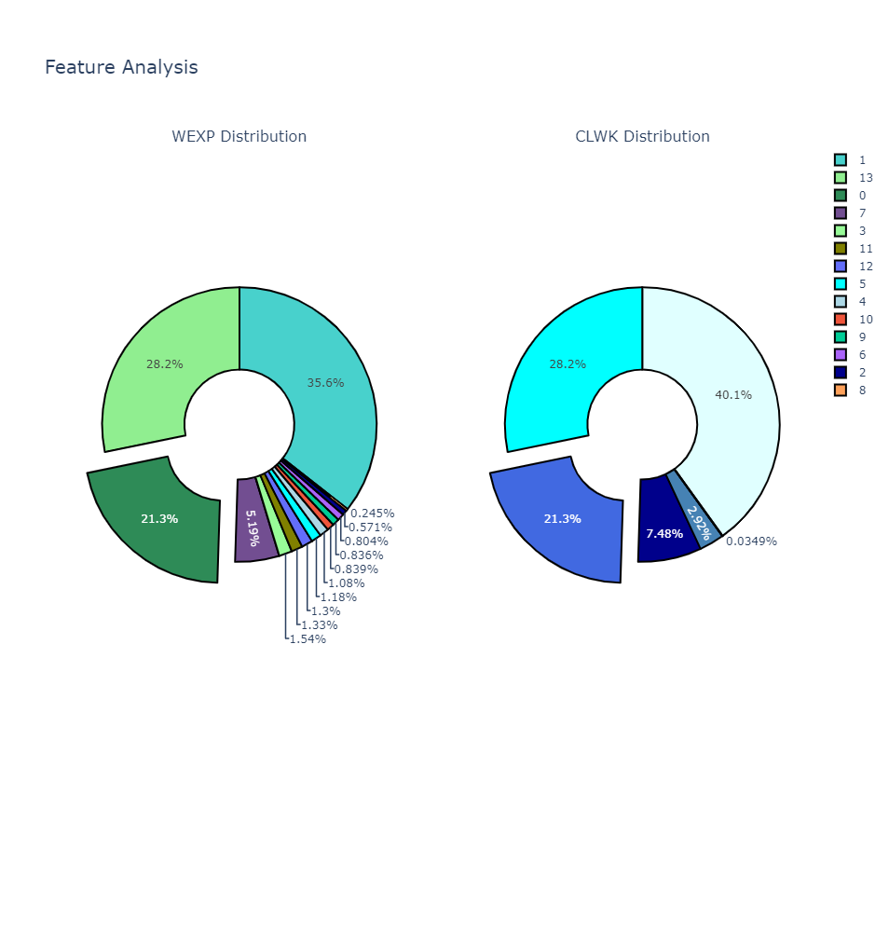
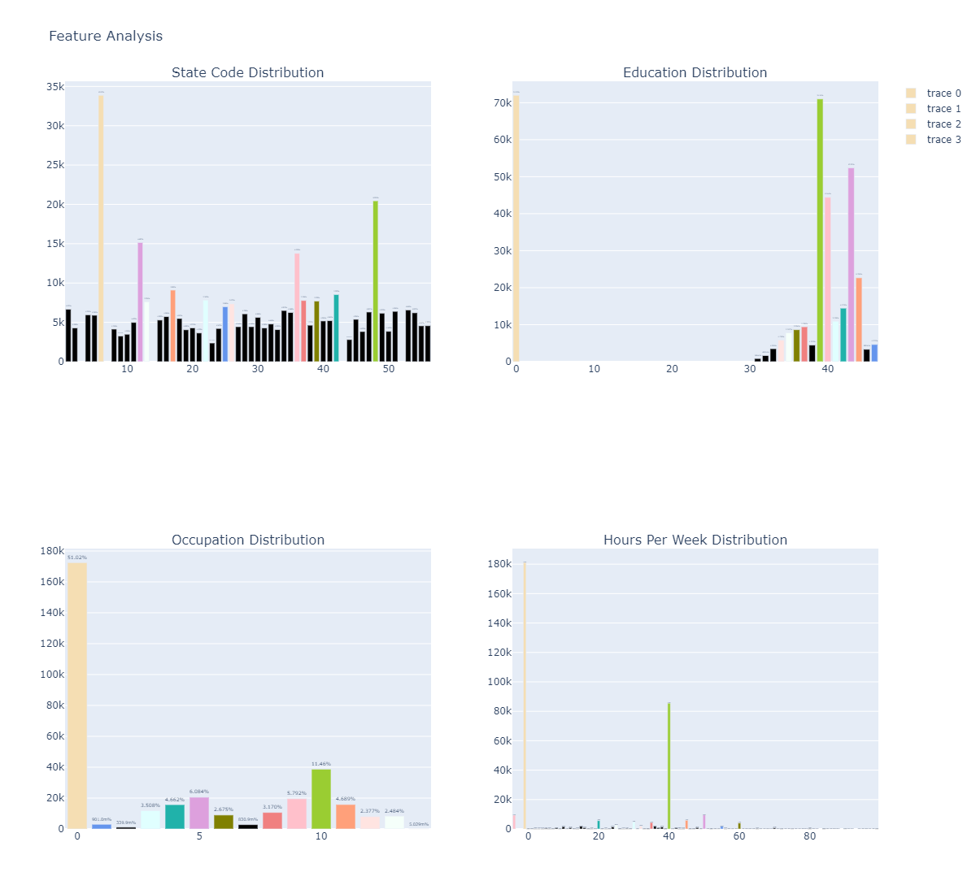
Distribution of Independent Variables
Dataset (338060 rows, 40 variables) - Includes Outliers
Notes:
Kevin
Start from left to right

Slide 8
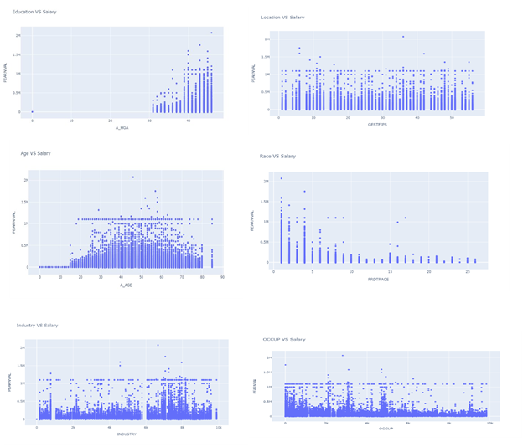
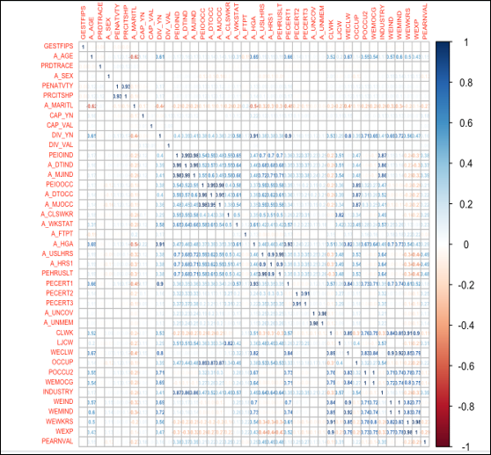
Relationships Between Salary and Predictor Variables (With Outliers)
Pearson Correlation (With Outliers)
Notes:
Mike –Right
Kevin -Left

Slide 9
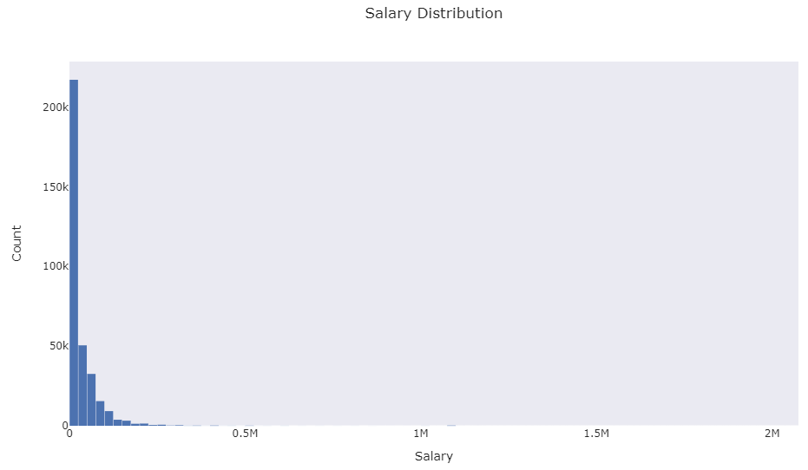
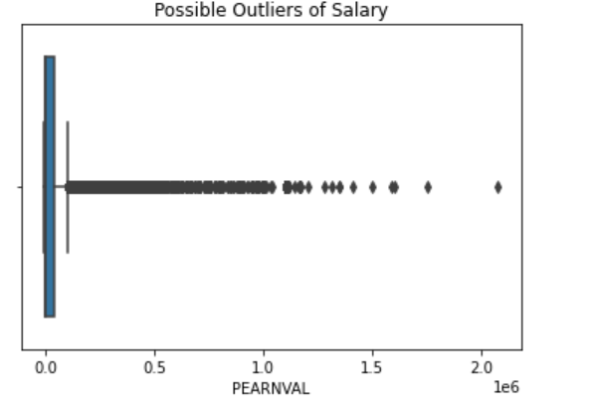
Salary Distribution – PEARNVAL
Identifying Outliers and New Dataset
IQR Method Used
Q1 = 0
Q3 = 40K
IQR = 40K
Range : -60K to 100K
Notes:
Ryan

Slide 10
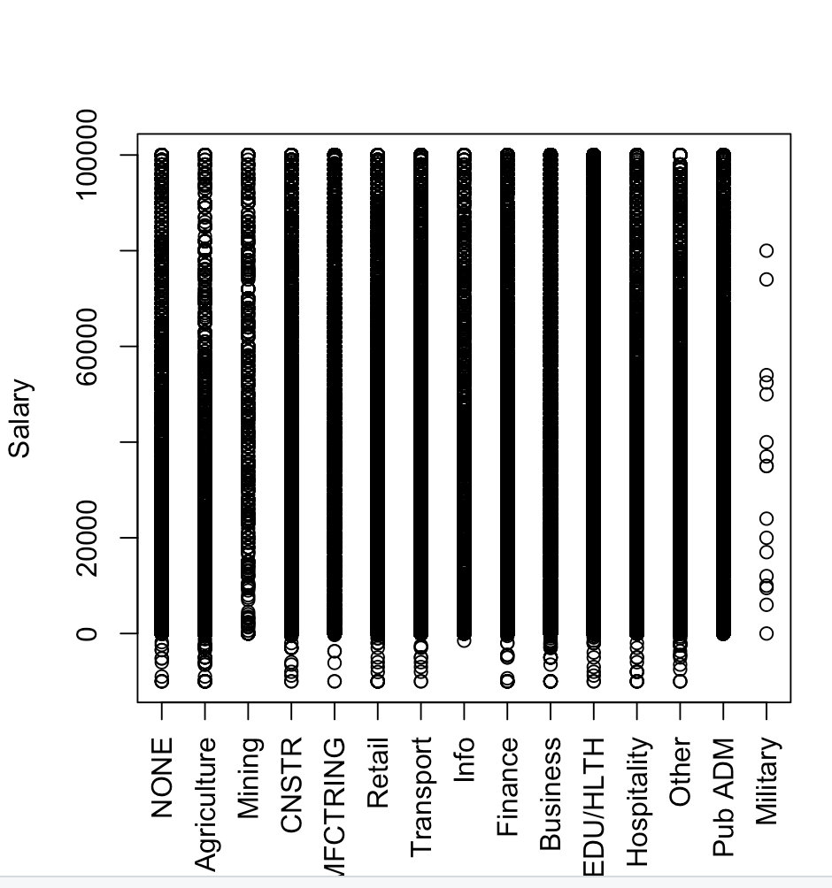
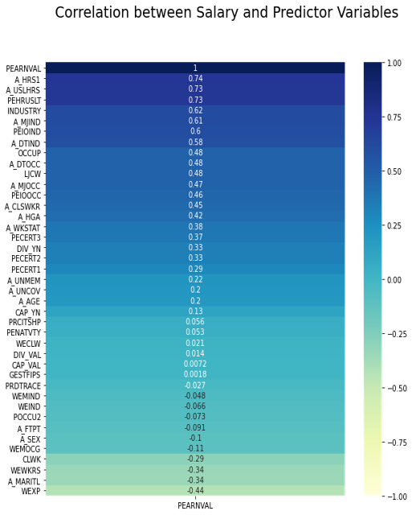
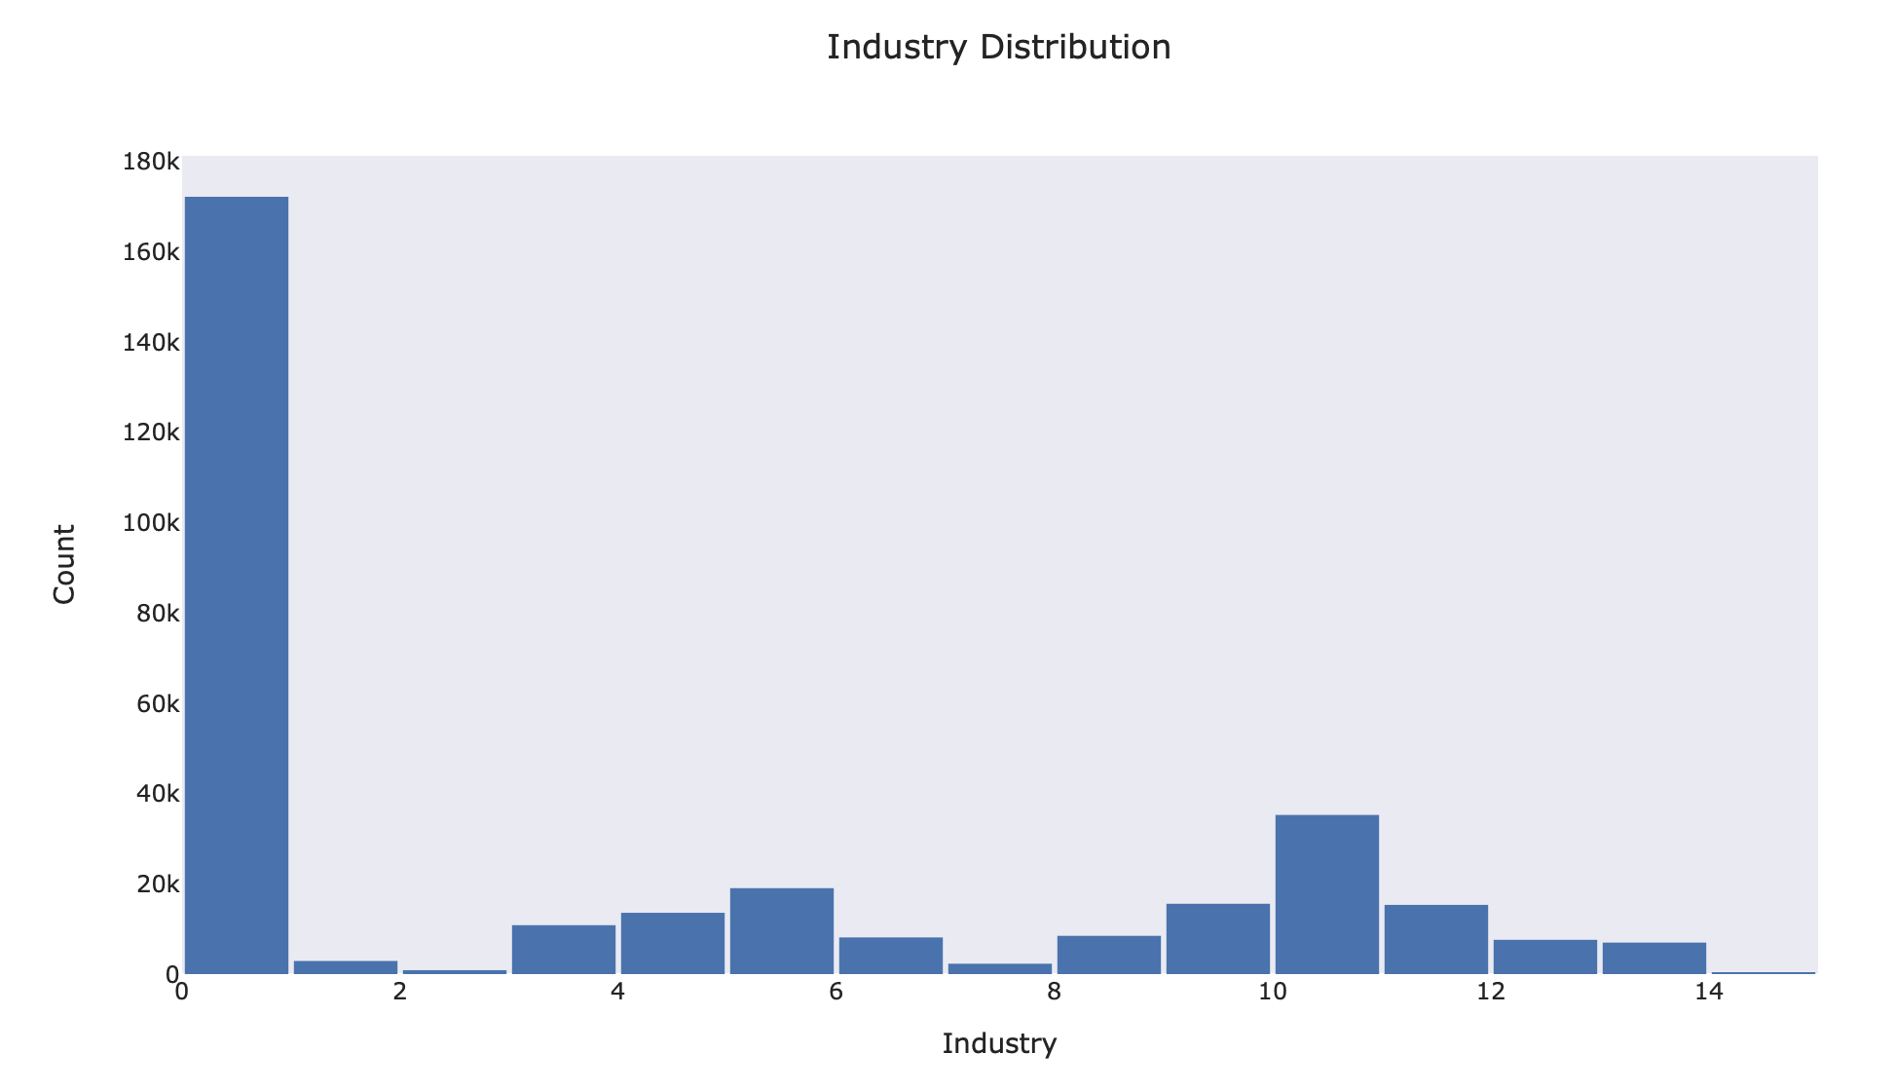
Salary Relationship with Predictor Variables
Figure 17: Salary Distribution Across Industries with No Outliers
Figure 15: Industry Representation without outliers
Visualization with Tableau
Notes:
Mike Walsh -Left
Ryan -Tableau
Alert audience of the y-axis
Look at the percentage of the “None” category and include in paper

Slide 11
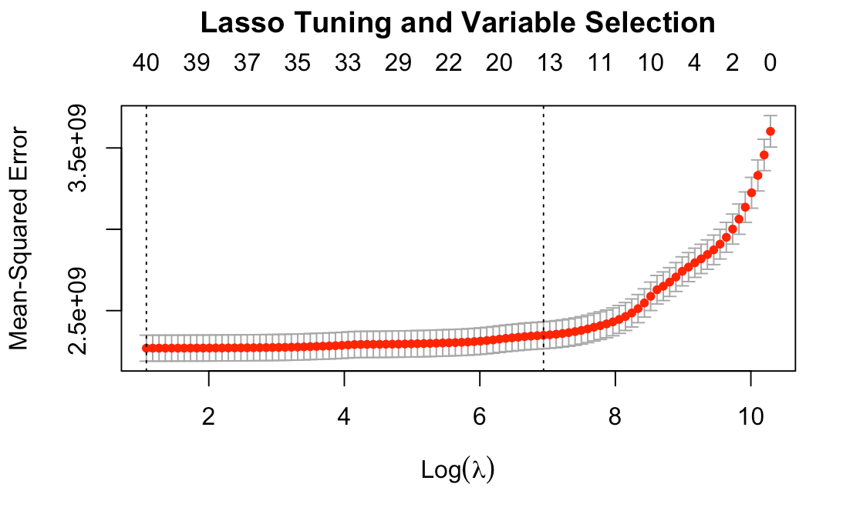
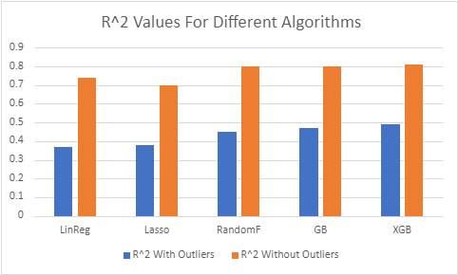
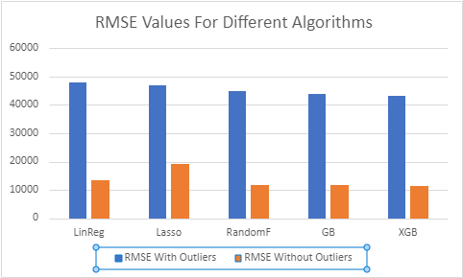
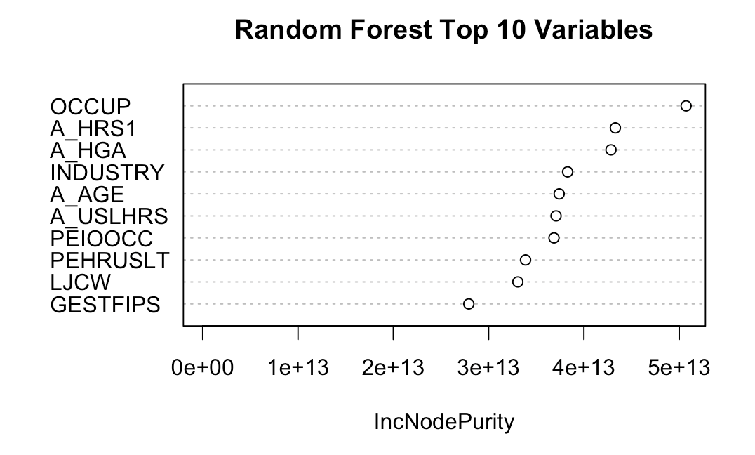
Algorithm Performance Metrics Comparison
Best Performance Algorithm: XGBoost
R-Squared = .81
Notes:
Glenn

Slide 12
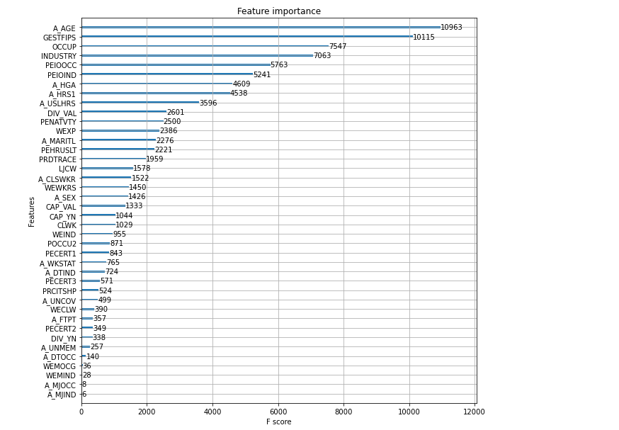
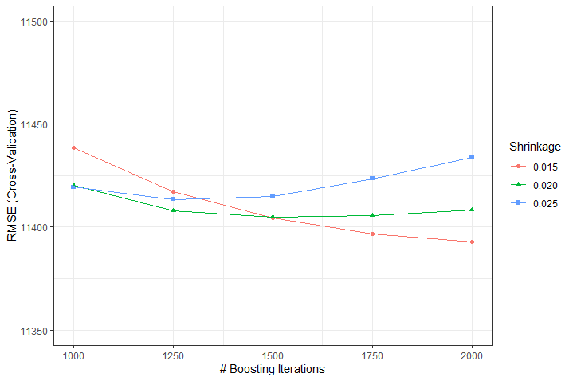
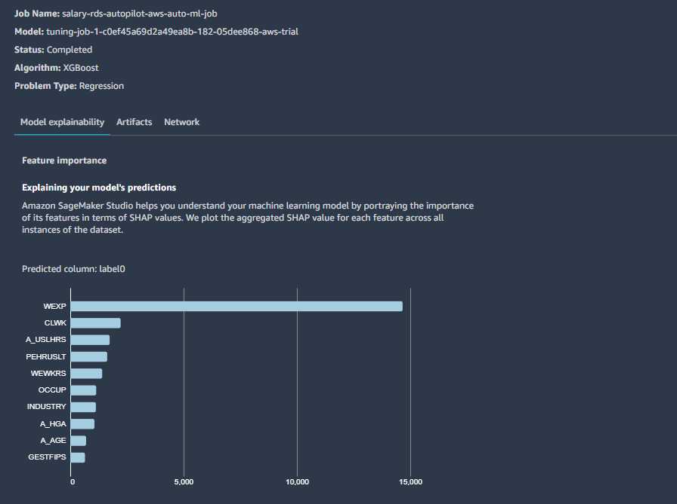
Extreme Gradient Boosting – Tree Based Learning
Best Algorithm: XGBoost​
Number of Jobs: 250​
Other Algorithms Used: linear lerner, mlp (all built-in algorithms from AWS )​
​
SHAP: contribution to the model prediction
Notes:
Kevin

Slide 13
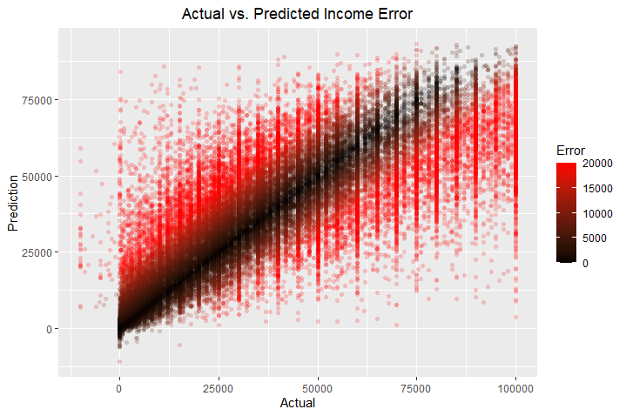
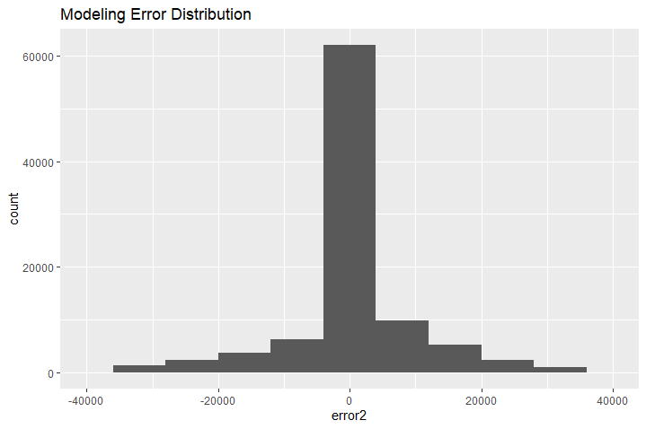
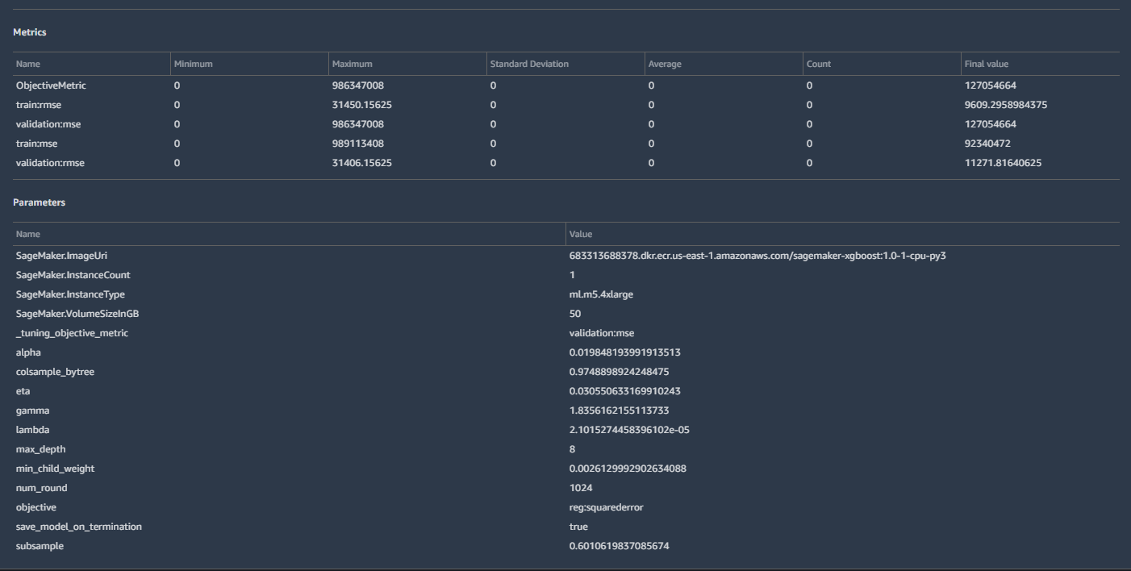
Actual vs Predicted Income Error
Modeling Error Distribution
Hyperparameter Tuning in SageMaker
Evidence of overfitting was present in both SageMaker and custom tuning
Final tuned model metrics
R-Squared = .82
RMSE = 11295
Notes:
Glenn and Kevin

Slide 14
Future Work
Findings
Using more factors and entries strengthened the model
XGBoost was the most accurate model
Experience (hours worked) and Industry are the highest factors that contribute to a higher salary, according to our correlation analysis
Variables like age, education, state, industry, hours worked, and occupation proved to be significant in both the XGBoost test from Python, and the SHAP values in SageMaker.
Distribution of data (lot of younger people without work experience)
Median salary in 2020 was $47,000 so classifying outliers after $100,000 is accurate from a practical perspective
Follow up with survey respondents who indicated NONE as their industry and/or work class
Focus on outliers and study existing and new factors that lead to a salary over 100,000
Why education attainment resulted in higher earnings for women, but that was not always the case for men
Deploy model to test with actual users (using AWS services)
Notes:
Lucien – Future Works
Ryan – Findings

Slide 15
Backup Slides

Slide 16
Project Risks and Mitigations
Risk Name | Risk Probability | Risk Impact | Risk Mitigation Strategies
If the dataset we select does not have accurate data, then we will be delayed in performing our analysis | 1 | 3 | We will look at several data sets so that if the primary set does not end up being accurate, we have a backup dataset to use
If the data we select is difficult to normalize and compare, then our analysis will not be as objective | 1 | 2 | We have done initial research into these data sets and we have alternate sets to use if this becomes an issue
If we select the incorrect attributes to focus on initially, then the schedule will be negatively impacted | 2 | 2 | We have begun analysis into these factors, already have a draft list we will use and have built in schedule slack
If the dataset does not contain data that is well correlated, then we will need to look elsewhere to support or analysis | 2 | 3 | Preliminary evaluations show some good correlation
Legend:
1 – Low
2 – Medium
3 - High

Slide 17
Complexity, Data Sources, Analytics
Complexity
Clean/normalizing the data
Since the Census dataset has more than 50 attributes, choosing the right attributes for our data might be complex
Quantifying the data and defining the impact on earning potential
Data Sources
UCI Adult Data Set: https://archive.ics.uci.edu/ml/datasets/adult
US Census Annual Social and Economic Supplements: https://www.census.gov/data/datasets/time-series/demo/cps/cps-asec.html
US Census APIs: https://www.census.gov/data/developers/data-sets.html
Potential Analytics
We are going to perform some preliminary analysis to explore the data and then pursue more targeted, deeper analysis with a variety of possible methods

Slide 18
Stories
Initial Stories
The stories that will be used to articulate how our software will provide value to the user are:
As an employer, I would like to know the factors impacting salary potential so that I know the correct amount to offer an employee to retain them.
As an employer, I would like to have a tool that allows me to offer a competitive salary to a potential employee so that I have a better probability of hiring them.
As an individual seeking employment, I would like to know how much an employer should offer to me such that I am compensated fairly.
As an individual seeking a higher salary, I need to know which controllable factors will lead to greater earning potential so that I can focus on those factors to enable greater earning.
As an individual seeking a higher salary, I need to prioritize factors that will lead to greater earning potential so that I can effectively use my time to pursue greater earning potential.
These stories will guide the team to evaluate factors impacting earning potential and aid us in drawing conclusions from those factors.
Lexicon
Self Employed Not Incorporated (Self-emp-not-inc): people who work for themselves in corporate entities
Factors: Columns in the dataset (ex, occupation, education)
Regression: Statistical model that shows relationships between variables
Salary: payment to employee for providing a service
Trends: direction in which an event or change is moving
Attributes: Properties of an entity

Slide 19
Field Descriptions
From hhpub20:
H_IDNUM: household id number. Same as characters 1-20 of PERIDNUM.
GESTFIPS: State FIPS code
GTCO: County FIPS code
From pppub20:
PEHRUSLT: Hours usually worked last week
A_AGE: Age
A_CLSWKR: workclass
A_MJIND: Major Industry Code
A_MJOCC: major occupation recode (related to above, maybe a little more specific)
A_FNLWGT: final weight
A_FTPT: Is ... enrolled in school as a full-time or part-time student
A_HGA: education level
CAP_YN: capital gain from shares or mutual funds (Y or N value)
CAP_VAL: capital gains value
DIV_VAL: how much a person received in dividends from stock
PTOT_R: total person income recode (values 0 to 41with ranges for each value)
PTOTVAL: total person’s income (negative if loss)
POTHVAL: all income not from earnings (negative if loss, could make the case for capital-loss like field)
PRDTRACE :race
A_SEX: sex
A_USLHRS: hours-per-week
PENATVTY: Birth Country
PECERT2: Does the individual have a professional certificate
PRTCITSHP: Citizenship group

Slide 20
Other Data Sources
We first came across UC Irvine’s “Adult Data Set” (Becker, 1996)
This data source was the impetus to our question regarding salary prediction and became a reference for us as we dug deeper into what we would need to predict salary
While this data set would possibly work for us, we ultimately decided against using it for a couple of reasons
Our first concern was that the salary attribute was not a specific salary amount but instead it was a binary category
Either the individual made over $50,000 or they made $50,000 or under.
This didn’t quite meet the needs of our project’s goal and we wanted to pursue other data sources that might meet these needs
Our second concern was the age of the data
The data was extracted from the 1994 Census database and, if we want to be able to provide current answers, we felt we needed more recent data
The other option we pursued was utilizing the Census website’s API capabilities in order to pull our own data
This would allow us to select which attributes we wanted, get more recent data, and have a better understanding of the dataset since we pulled it together
We ultimately decided against this option for one key reason: potential issues with learning to scrape the data
Doing so incorrectly could lead to improper data or more work with cleaning up the data than we necessarily wanted to take on
The risks of that simply outweighed the pros given the benefits of the data source we ultimately landed on

Slide 21
Risks Associated with the Algorithms
Probability | Impact | Mitigation
Pearson Correlation
Incorrect calculations or interpretations can lead to inaccurate conclusions
Linear Regression
Unsuitable variables might require adjustments to prediction/analysis goals
Accuracy
Low accuracy might make the model not useful
1 | 3 | Code Review
1 | 2 | Data cleaning and normalization
2 | 2 | Running model multiple times
Legend:
1 – Low
2 – Medium
3 - High
Notes:
Move to backup

Slide 22
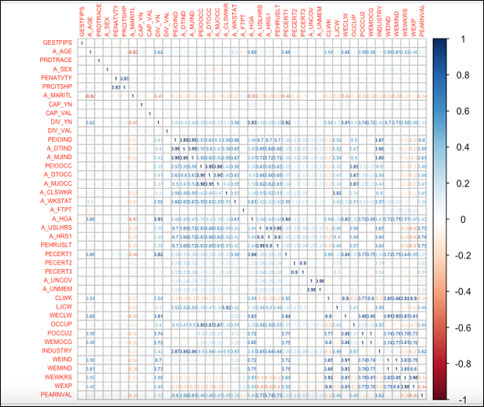
Correlation Between All Attributes
With Outliers
Without Outliers
Notes:
Mike Walsh
Slide should stay

